Slide 1
Decomposition
TREE
Decomposition
TREE

Slide 2
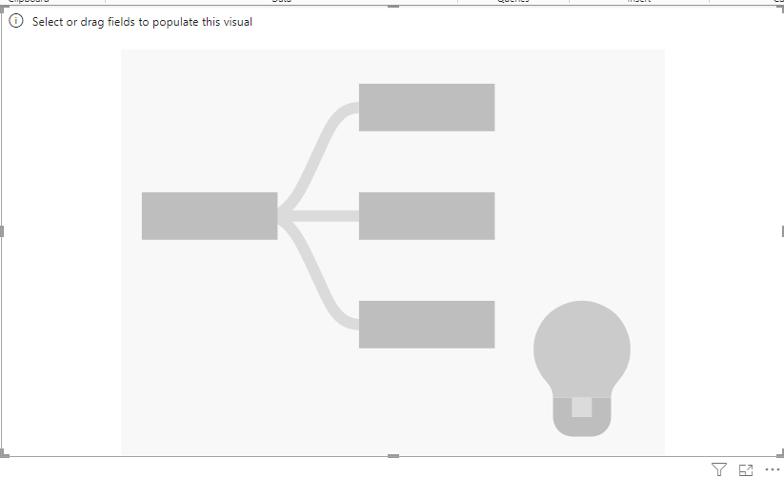
Decomposition tree
Note: This workshop is based on the Excel file Sales.xlsx in the Excel
Add a decay tree to the scene

Slide 3
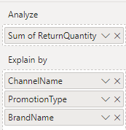

Decomposition tree
Add the returned quantity from the FactSales table to the analysis and channel name ,
to the type of promotion and the brand name and observe
Suggestions for analysis
The total quantity returned

Slide 4
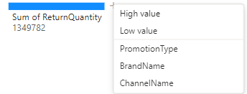
Decomposition tree
If you click first, Power BI will suggest it based on
IA which axis of analysis comes first, i.e. the type of promotion
or the brand name or the channel name and that gives
the highest values of the return quantities based on this
Axis of analysis
Click on the sign +
If you click first, Power BI will suggest it based on
AI which analysis axis comes first is the type of promotion
Or the brand name or the channel name and that gives
The lowest values of return quantities based on this
Axis of analysis

Slide 5
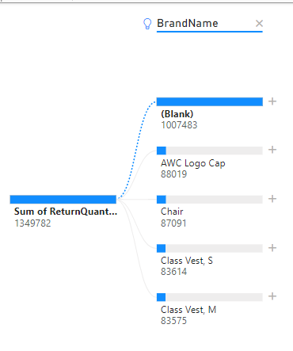
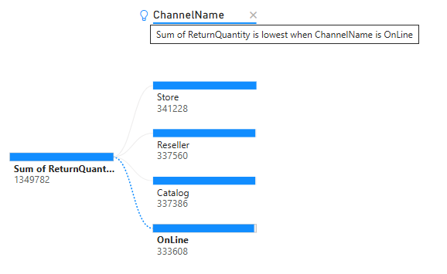
Decomposition tree
The light blur indicates some useful
information about the analysis

Slide 6
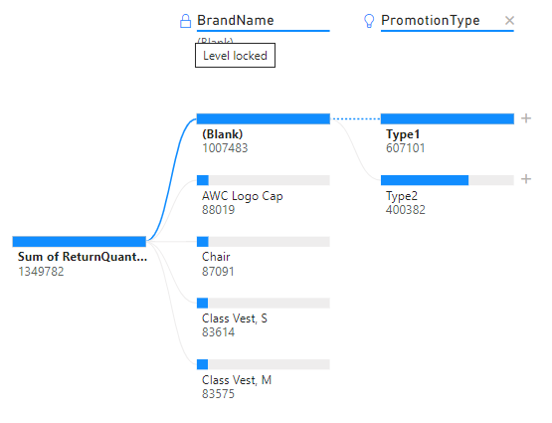
Decomposition tree
Double-click on the analysis axis and a lock sign will appear , meaning the axis is now fixed and cannot be replaced until it is unlocked.

Slide 7
Thank you
Thank you

